Slide 1
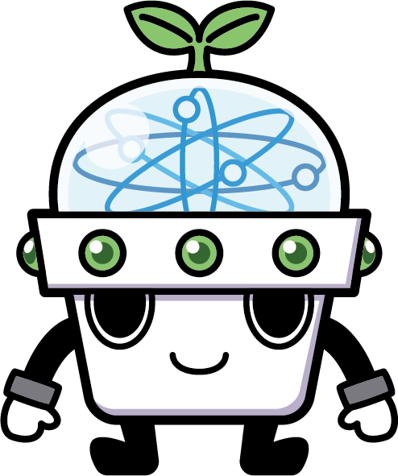
Introduction to Python

Slide 2
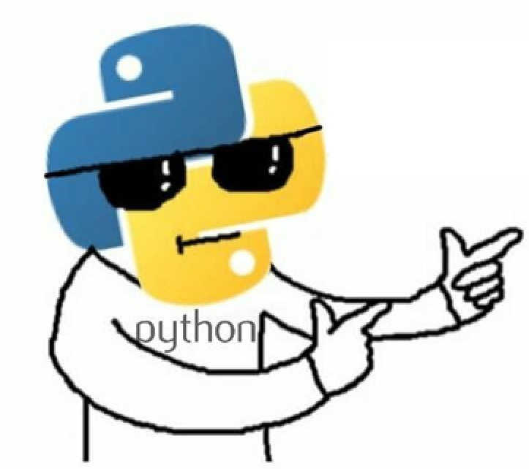
Python

Slide 3
Step Back Little before Python Enters
Multiple lines of programming
No special modules
Confusing Data Structures concepts
More time investment
Automations is quite hard
Scripting was little challenge

Slide 4
Quick History of Python!!! Guido van Rossum - 1991

Slide 5
How Python Stands Unique!!!
Free & Open source
High Level Programming Language
Object Oriented Programming Language
Interpreted Language
Dynamic Synatax
Unique AI, Web, Libraries
Production Friendly

Slide 6
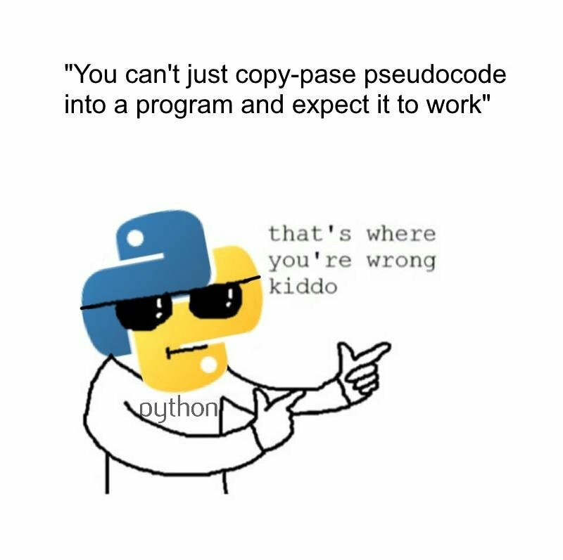
Why Python
Easy to Use
Code Effort is less
Open Source

Slide 7
Python Vs C Vs Java
C :
# include <stdio.h>
Int main ()
{
printf (“Hello World! \n”);
return 0;
}
Java:
Public class Hello
{
public static void main (String argv[])
{
System.out.println(“Hello World!”);
}
}

Slide 8
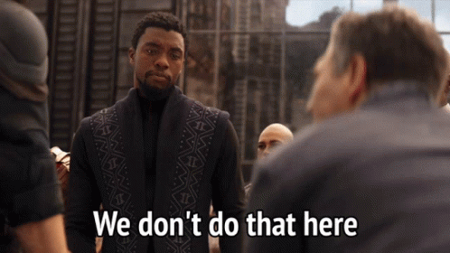

Slide 9
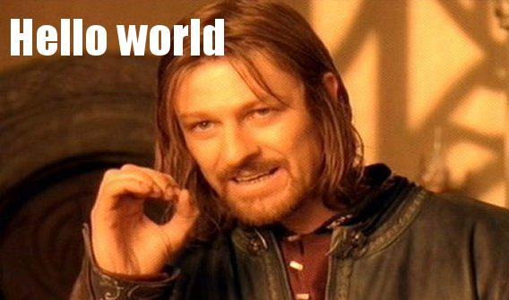
Python Vs C Vs Java
Python:
print (“Hello World!”)

Slide 10
Usages
Artificial Intelligence
Database Access
Network Programming
Automation Software's
Web Development
Games and 3D Graphics
Image Processing.

Slide 11
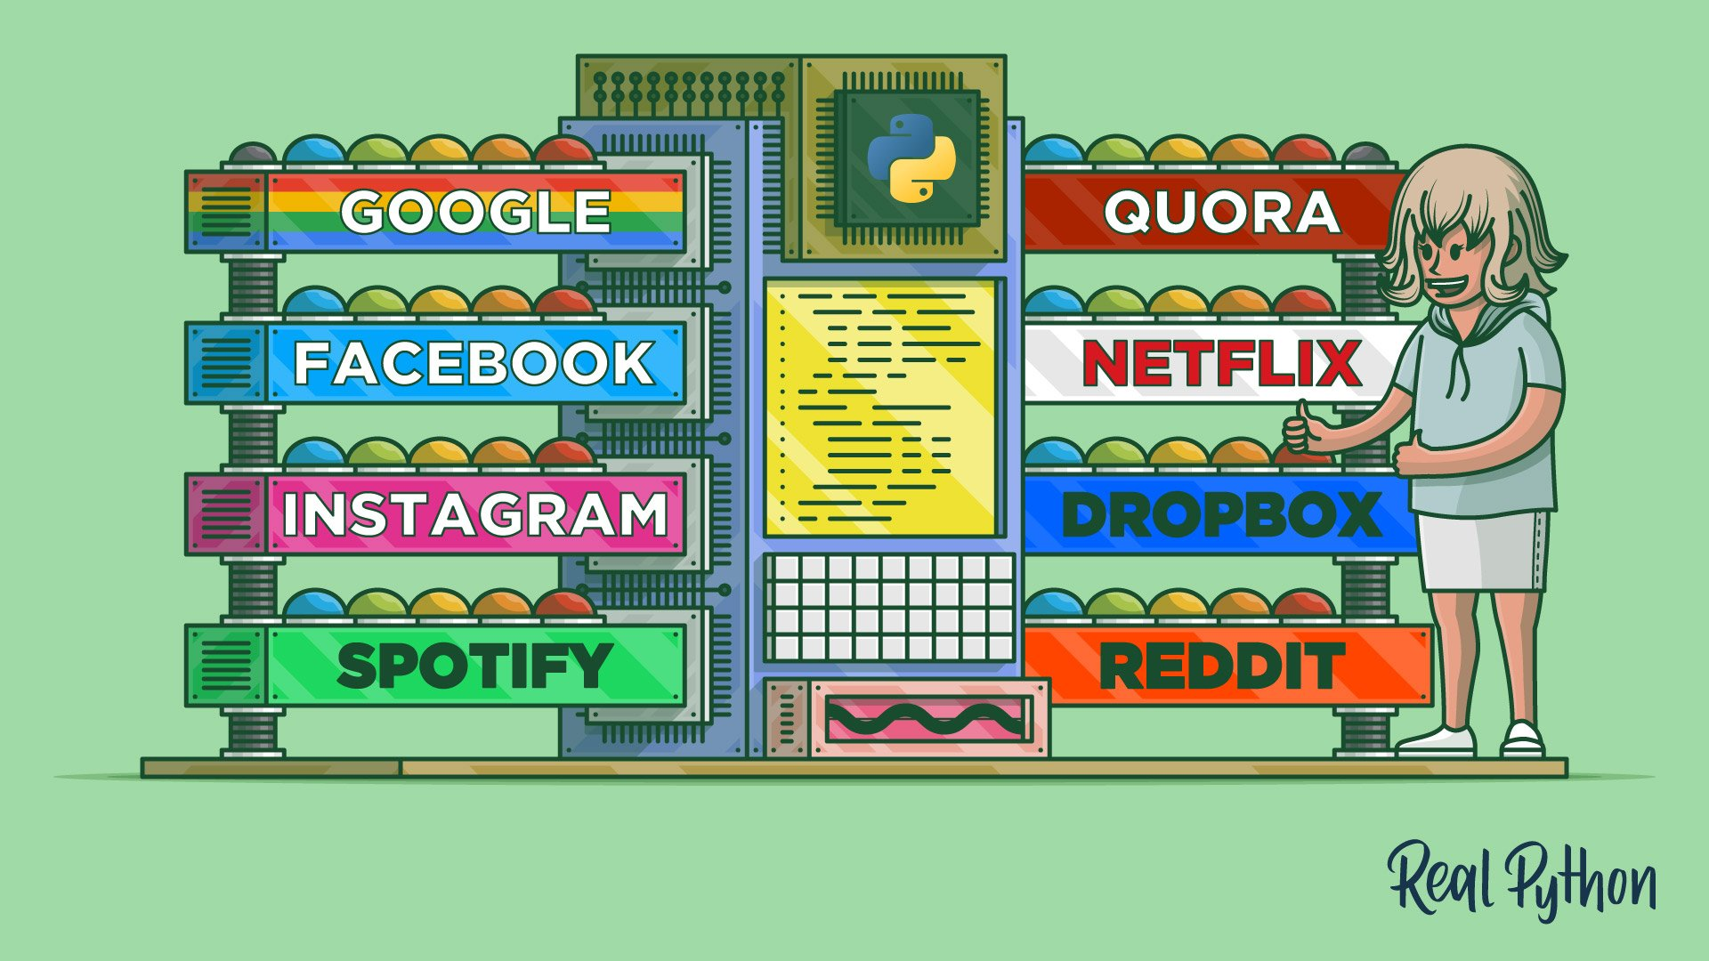

Slide 12

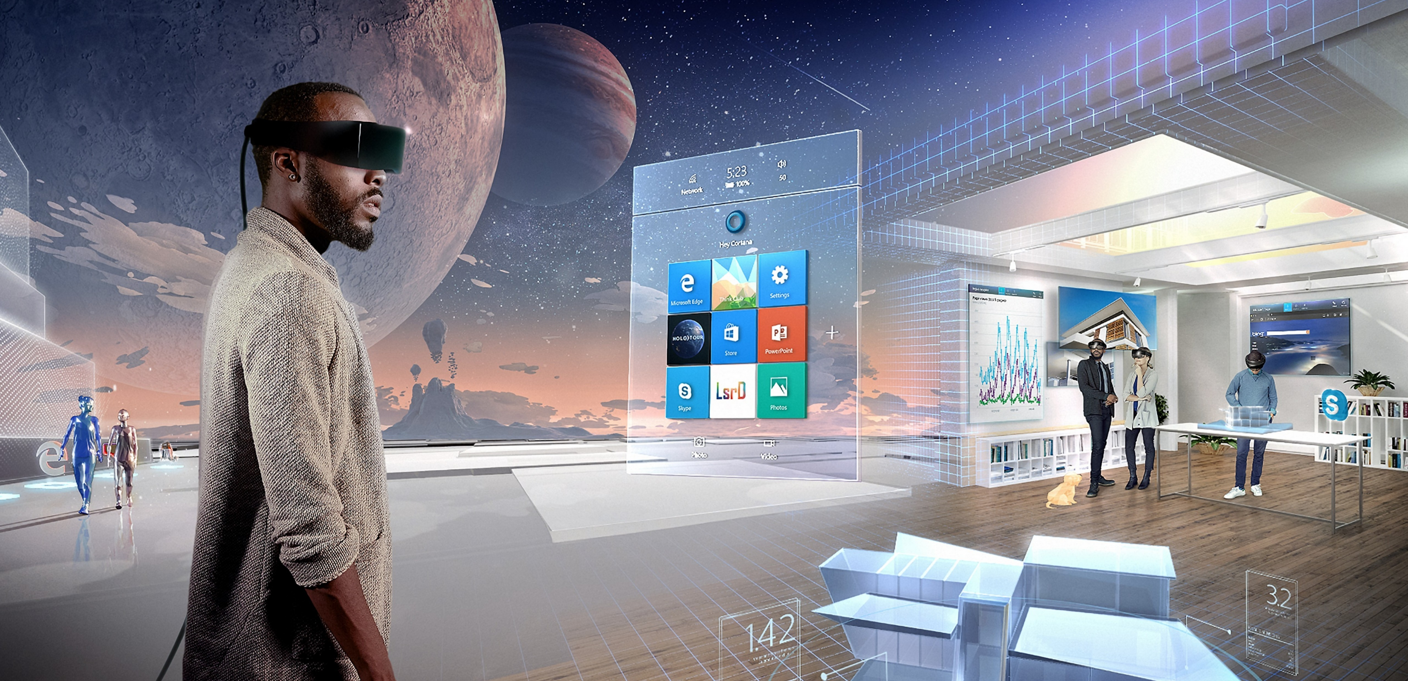
Trendy Talks !!!

Slide 13

Its time for Action!

Slide 14
